Slide 1
Obey the general contract when overriding equals

Slide 2
When to override equals
value classes.:A value class is simply a class that represents a value, such as Integer or String. Only exception here is that classes which have instance controls like Enums.For these classes, logical equality is the same as object identity, so Object’s equals method functions as a logical equals method.
when a class has a notion of logical equality that differs from mere object identity and
a superclass has not already overridden equals.

Slide 3
When to override equals
Remember to follow certain rules and guidelines while overriding equals():
Reflexivity: x.equals(x) should always return true.
Symmetry: If x.equals(y) returns true, then y.equals(x) should also return true.
Transitivity: If x.equals(y) and y.equals(z) return true, then x.equals(z) should also return true.
Consistency: Repeated calls to equals() should consistently return the same result.
Null check:It says that all objects must be unequal to null.

Slide 4
when not to override
Issues can come when we override super class equal method
public static void main(String[] args) {
Vehicle vehicle = new Vehicle("123");
Car car = new Car("123", "Toyota");
System.out.println(vehicle.equals(car)); // Output: true or false?
System.out.println(car.equals(vehicle)); // Output: true or false?
}

Slide 5
Solution
Avoid Liskov Substitution Principle Violations:
Ensure that subclass instances can be substituted for superclass instances without affecting correctness. Violating this principle can lead to unexpected behavior when using polymorphism and inheritance.
“Favor composition over inheritance.”
instead of car extending vehicle, create a field member called vehicle in car class.
Abstarct class with no value componenet
you can add a value component to a subclass of an abstract class
without violating the equals contract. This is important for the sort of class hier_x0002_archies that you get by following the advice in Item 23, “Prefer class hierarchies to
tagged classes.” For example, you could have an abstract class Shape with no
value components, a subclass Circle that adds a radius field, and a subclass
Rectangle that adds length and width fields. Problems of the sort shown earlier
won’t occur so long as it is impossible to create a superclass instance directly

Slide 6
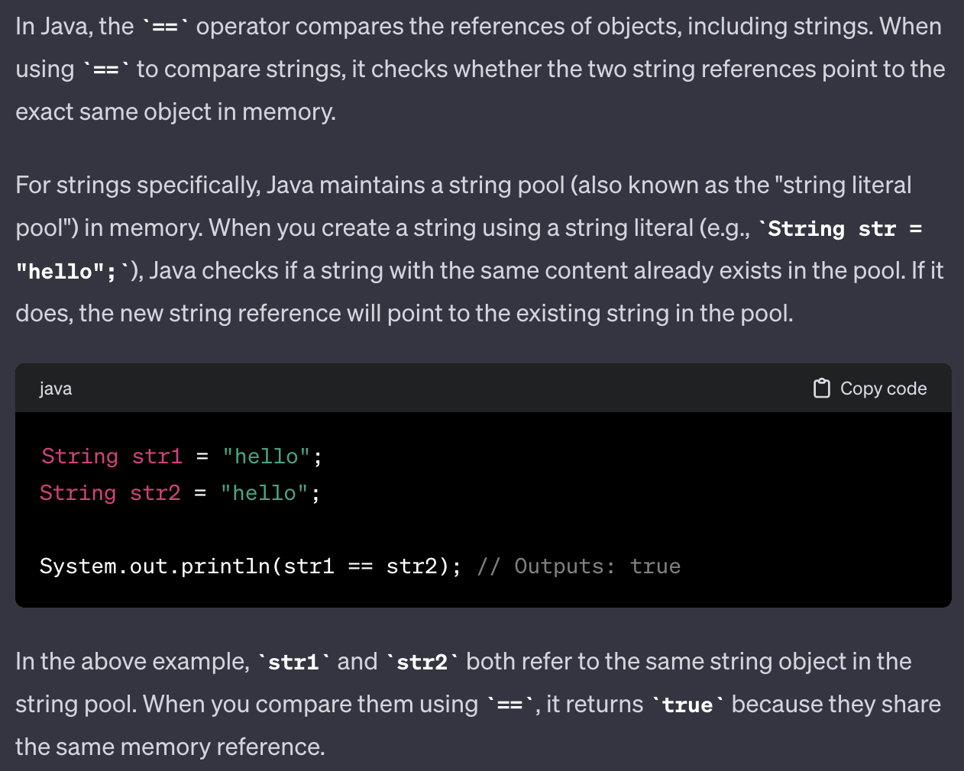
String equals method

Slide 7
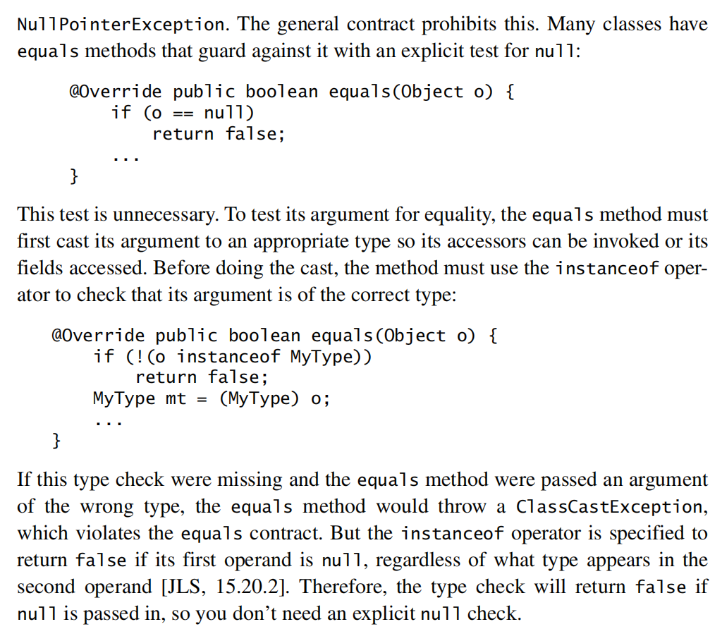
Null condition check
the type check will
return false if null
is passed in,
so you don’t
need an explicit
null check.

Slide 8
Suumay
Use the == operator to check if the argument is a reference to this object.
Use the instanceof operator to check if the argument has the correct type.
Cast the argument to the correct type after checking instance of
Some object reference fields may legitimately contain null. To avoid thepossibility of a NullPointerException, check such fields for equality using the static method Objects.equals(Object, Object).
use the static Float.compare(float, float) method; and for double fields, use Double.compare(double, double). This gives performance advantage as it avoids autoboxing in default equals method

Slide 9
Summary
6.When you are finished writing your equals method, ask yourself three questions: Is it symmetric? Is it transitive? Is it consistent?.write unit tests to check,
7.Always override hashCode when you override equals
8. Don’t substitute another type for Object in the equals declaration.
public boolean equals(MyClass o)// wrong
it is an overloaded method
Consistent use of the Override annotation, as illustrated throughout this item,will prevent you from making this mistake

Slide 10
Google’s open source AutoValue framework,
this will write equals method automatically for us by single annotation

Slide 11
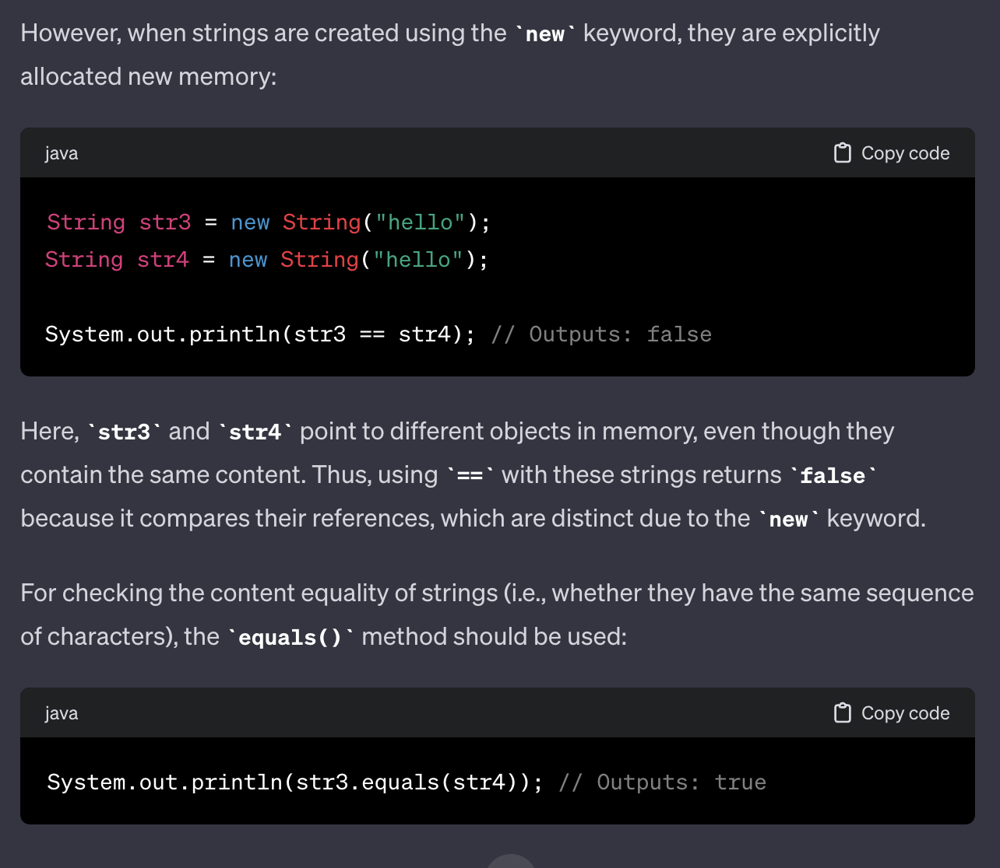
String equals method

